Slide 1

VISHESHAM
विशेष रूप से सक्षम

Slide 2


ABSTRACT
This research primarily focuses on enhancing communication between all civilian categories in the society.
It's main goal is to bridge the gap between verbal as well as non-verbal language and the precise interpretation of these languages.
The scope of the project is futuristic.
Our study is exploratory and subject to enrichment.

Slide 3

DATA ANALYSIS
Considering the demand for Global Sign Language Web Apps, we see a significant growth with respect to the trend line for the demand of such Web Apps.
The following Bar Graph depicts the current as well as futuristic market size for such Web Apps which appear to have an upward curve.
As societies around the world become more attuned to the importance of accommodating diverse needs, there is a rising expectation for online platforms to be inclusive of individuals with varying communication abilities.

Slide 4
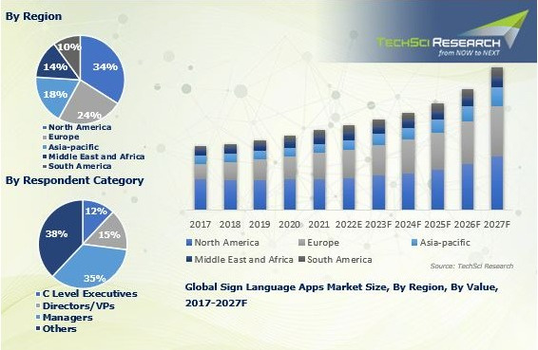

Slide 5
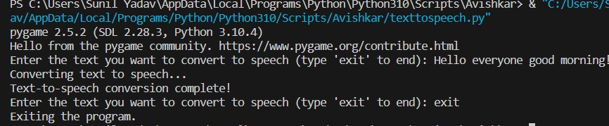
SOFTWARE
TEXT TO SPEECH

Slide 6
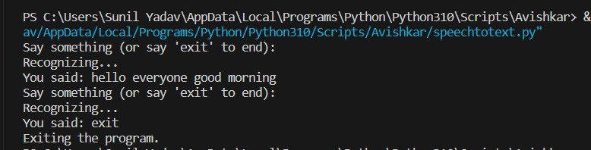
SOFTWARE
SPEECH TO TEXT

Slide 7
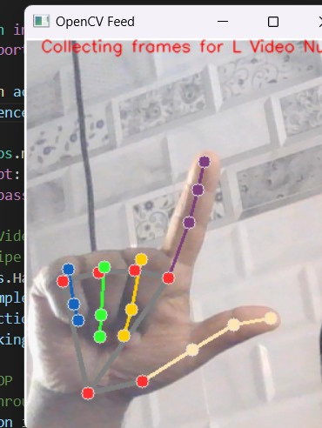
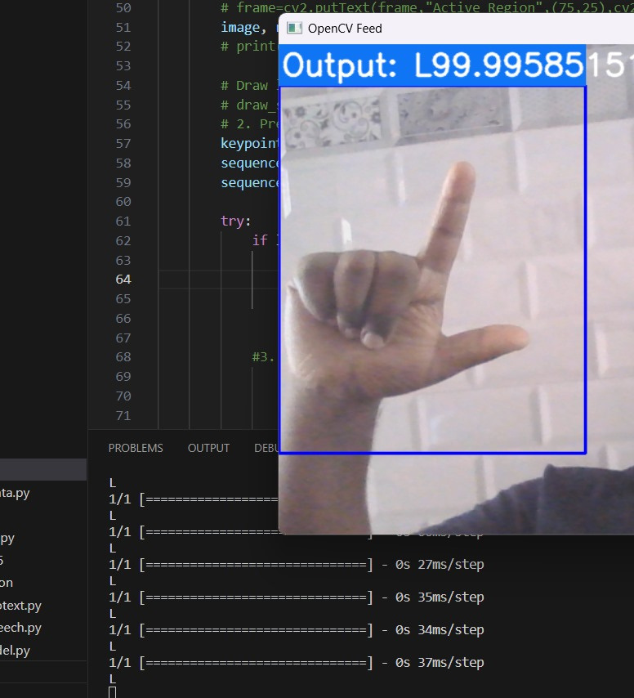
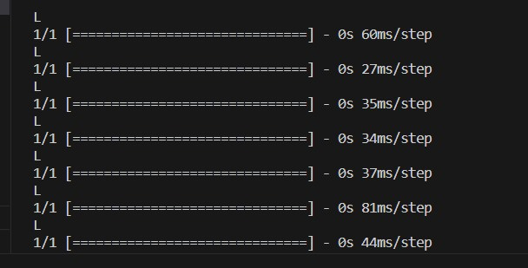
SOFTWARE
GESTURE TO TEXT

Slide 8

CONCLUSION
In conclusion, our Global Sign Language Web Application stands at the intersection of innovation and inclusivity, addressing a growing demand for accessible and diverse digital experiences. The upward trend in the market size, as depicted in our analysis, underscores the relevance and potential impact of our project.
By harnessing the power of Python libraries, TensorFlow, and React, we are not just creating a web application, we are contributing to a global movement towards a more inclusive digital space.

Slide 9


SOCIAL RELEVANCE
Inclusive Communication
Equal Opportunities
Breaking Social Barriers
Educational Empowerment
Independence & Autonomy
Cultural Preservation
Advocacy for Accessibility

Slide 10


REFERENCES
Secondary data has been collected via Websites, Theories, Reports and Statistical Data generated by officials and related articles.
LINKS:
https://www.sciencedirect.com/science/article/pii/S2352914822002131 (Need)
https://www.sciencedirect.com/scie(nce/article/pii/S2667305321000454 (ML Necessity)
https://www.researchsquare.com (Research Documentation)

Slide 11



